Slide 1

Block coding Developer
Session - 35
Introduction to HTML Basics

Slide 2


Recall
What we have learnt in last session
What challenges you are facing

Slide 3

HTML Introduction
We will Learn today:
Introduction to HTML
Structure of HTML
What is Heading
What is Paragraph
What is Tag

Slide 4
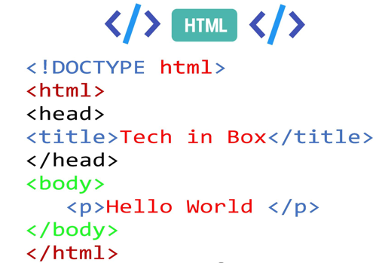
What is HTML?
HTML stands for Hyper Text Markup Language
HTML is the standard markup language for creating Web pages
HTML describes the structure of a Web page
HTML documents are describe by html tags
HTML elements tell the browser how to display the content
HTML uses HTTP (Hyper text Transfer protocol)

Slide 5

Father of HTML
The first publicly available description of HTML was a document called HTML Tags
First mentioned on the Internet by Tim Berners-Lee in late 1991

Slide 6
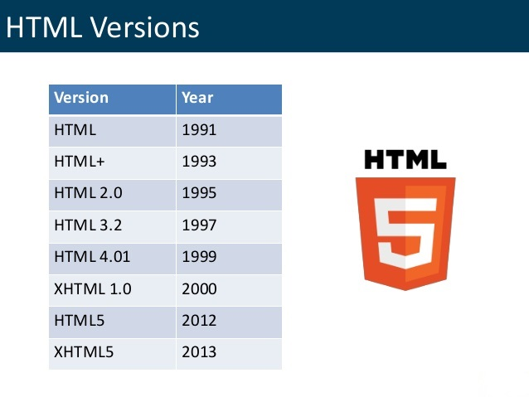
HTML Versions:-

Slide 7
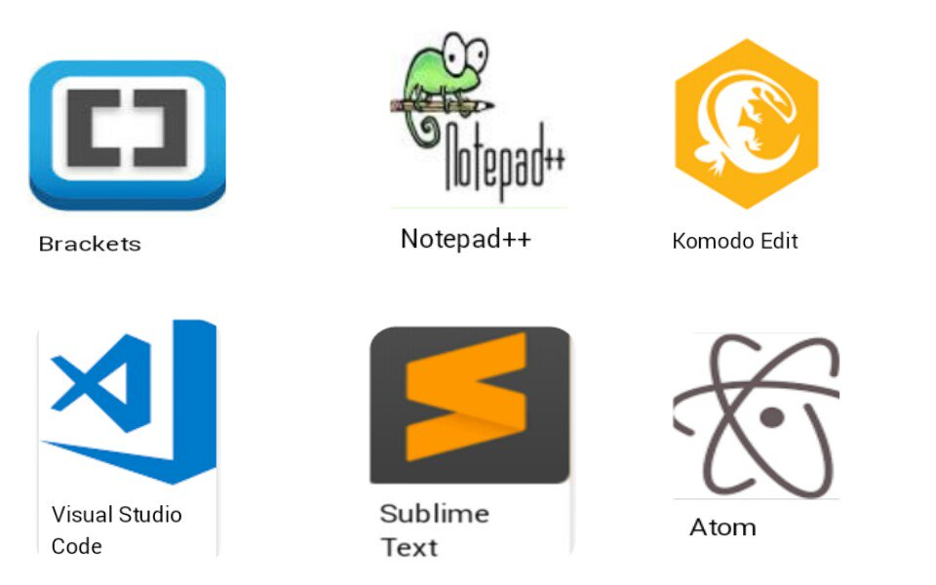
HTML Editors
Notepad
Notepad++
WordPad
Sublime text 3
Atom
Komodo Edit
Visual Studio Code

Slide 8
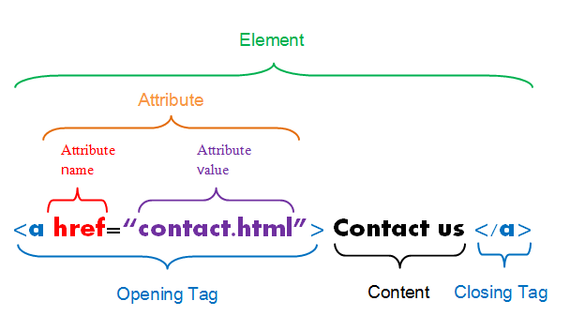
HTML Tags:-
HTML tags are keywords (tag names) surrounded by angle brackets:
<tagname>content</tagname>
HTML tags normally come in pairs like:
The first tag in a pair is the start tag, the second tag is the end tag
The end tag is written like the start tag, but with a slash before the tag name
You can use either .htm or .html as file extension

Slide 9
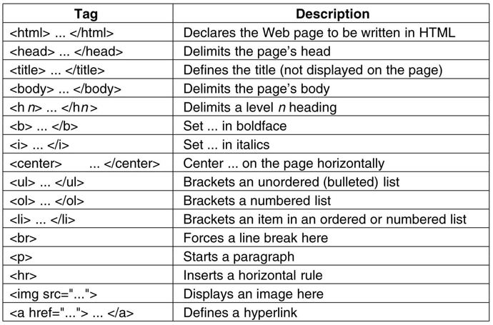
Different HTML Tags:-

Slide 10
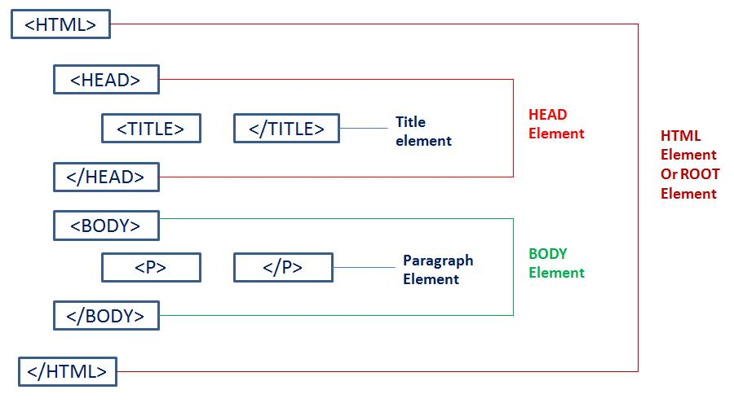
Structure of Html
The <html> element is the root element of an HTML page
The <head> elements meta information about the HTML page
The <title> elements specifies the title for the HTML page
The <body> elements define the documents body and is the container for all the visible contents .

Slide 11
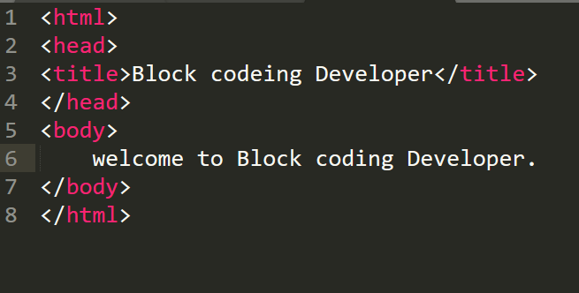
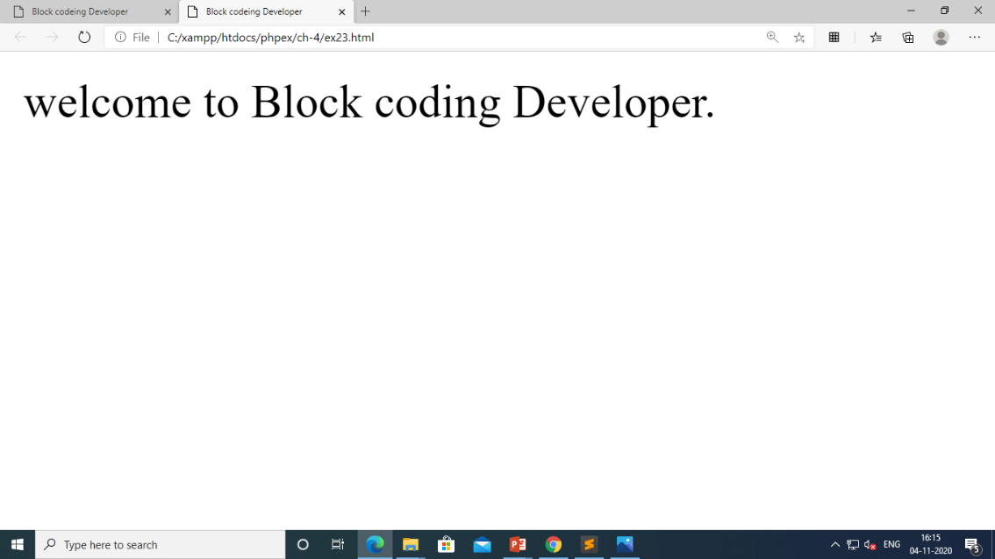
Example – HTML Structure

Slide 12
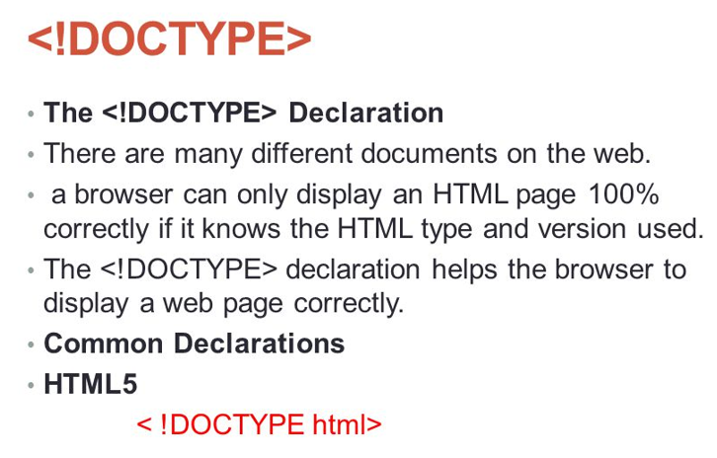
<!DOCTYPE> Declaration
<!DOCTYPE> declaration represents the document type, and helps browsers to display web pages correctly
The <!DOCTYPE> declaration is not case sensitive
It must only appear once, at the top of the page

Slide 13
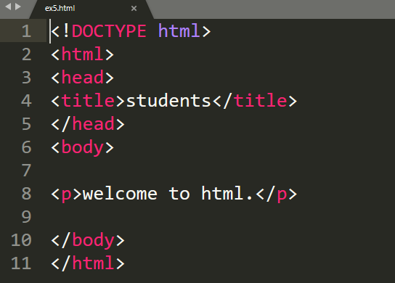
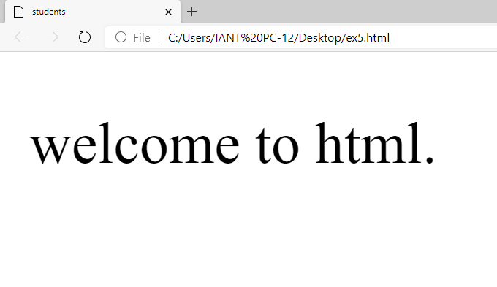
Example - <!DOCTYPE> Declaration

Slide 14
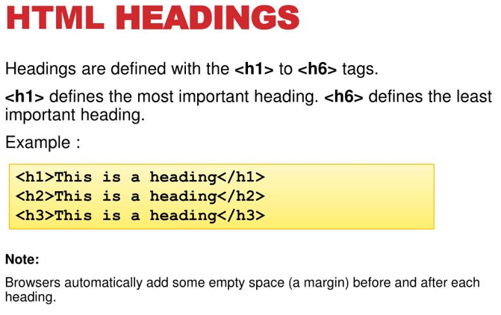
What is Heading?
HTML defines six levels of headings
The heading elements are H1, H2, H3, H4, H5, and H6 with H1 being the highest level and H6 the least
HTML heading are defined with the <h1> to <h6> tags

Slide 15
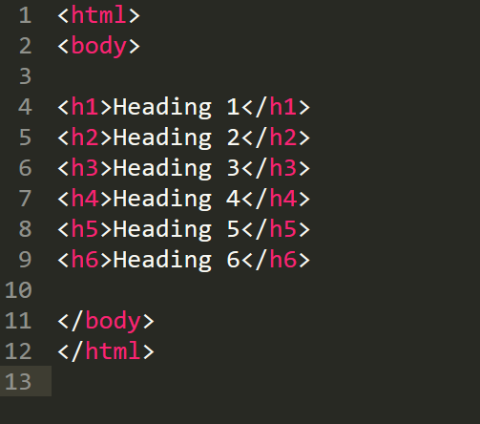
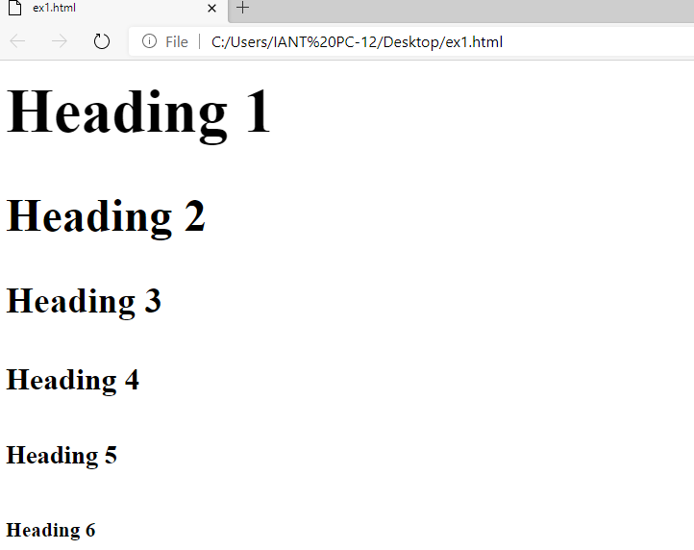
Example - Headings

Slide 16
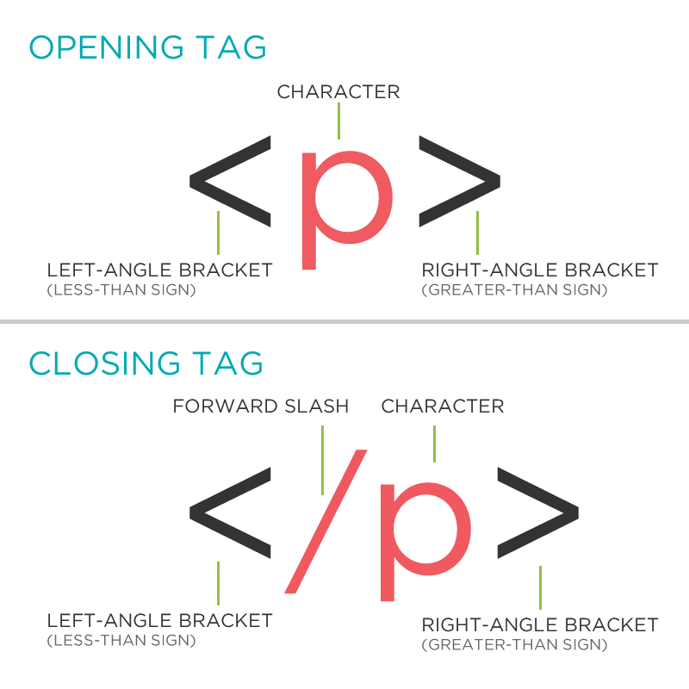
What is Paragraph?
The HTML <p> element represents a paragraph
Browsers automatically add a single blank line before and after each <p> element
A paragraph always starts on a new line, and is usually a block of text

Slide 17
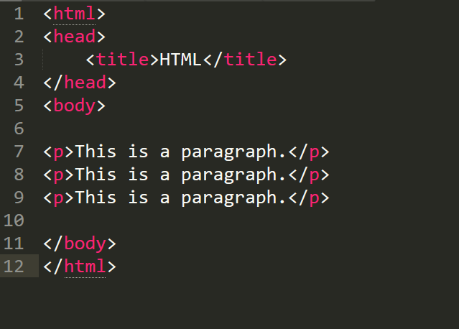
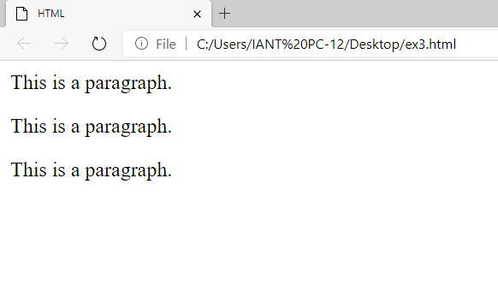
Example - Paragraph

Slide 18
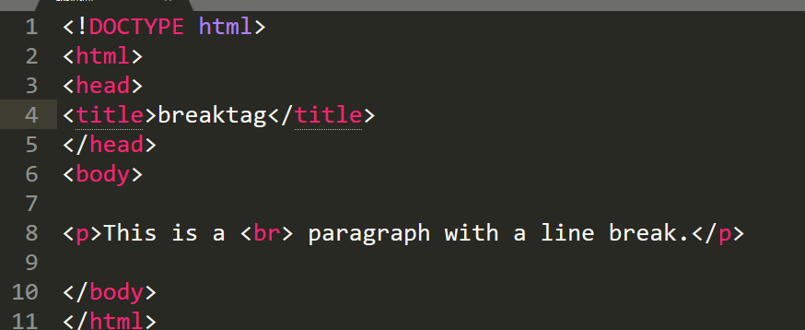
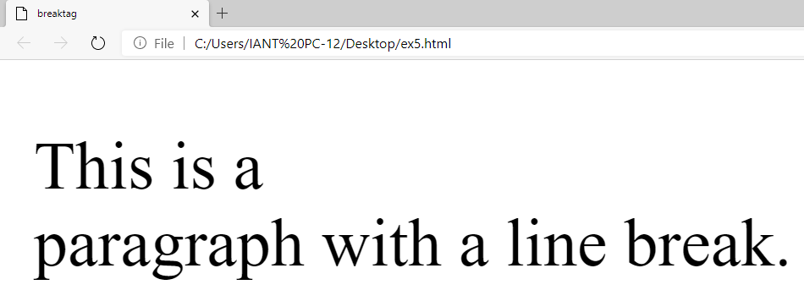
<br> Tag
The <br>tag defines a line break and is an empty is an empty element without a closing tag

Slide 19
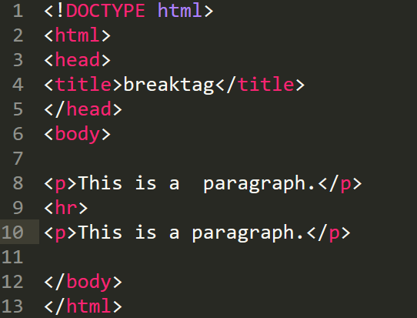
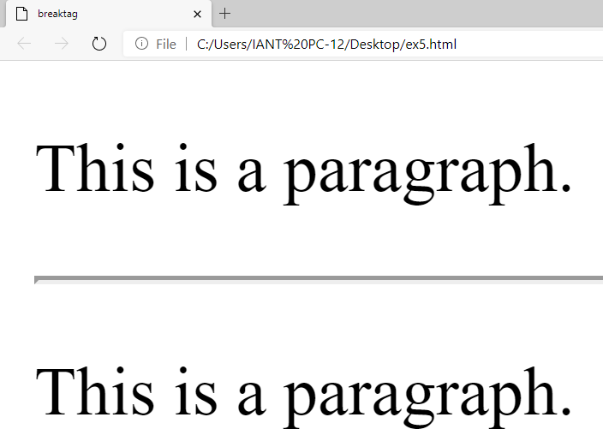
<hr> Tag
The <hr> element is most often displayed as a horizontal rule that is used to separate content in a HTML page

Slide 20
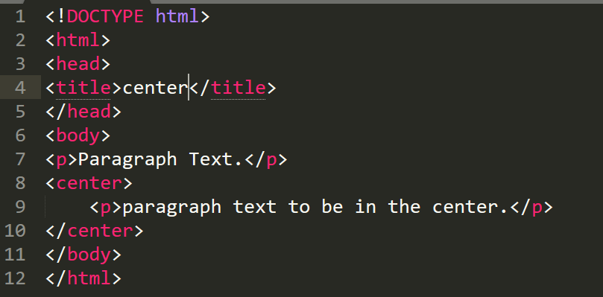
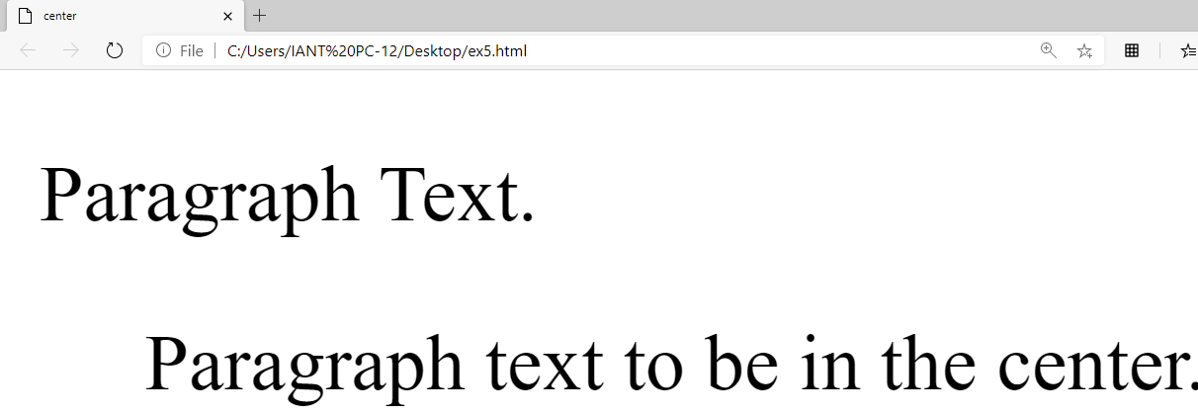
<center> Tag
To align the text in center

Slide 21
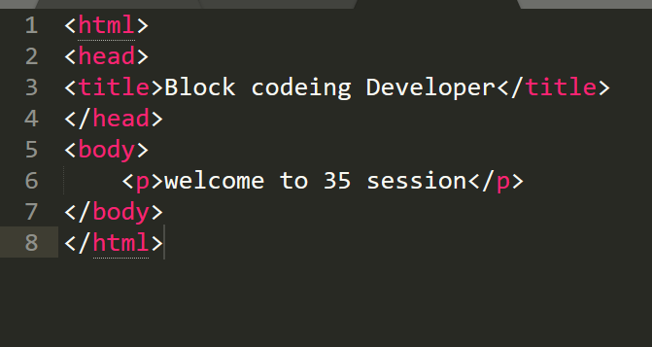
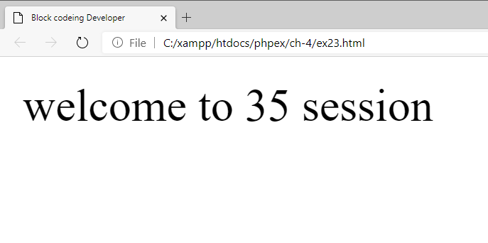
<p> Tag
To define Paragraph

Slide 22
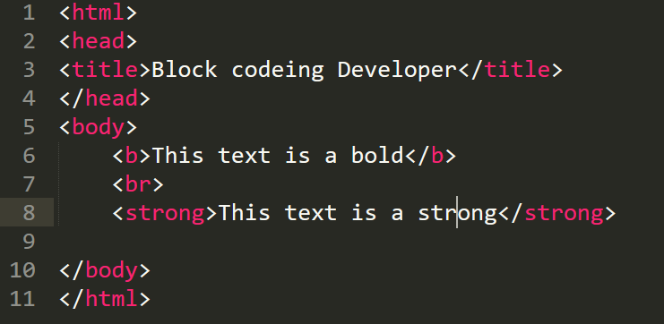
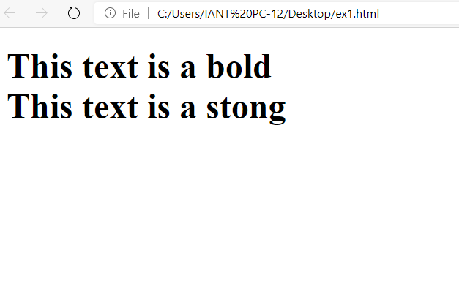
<b> Tag & <strong> Tag
<b> Define bold text
<strong> Define important text same as bold

Slide 23
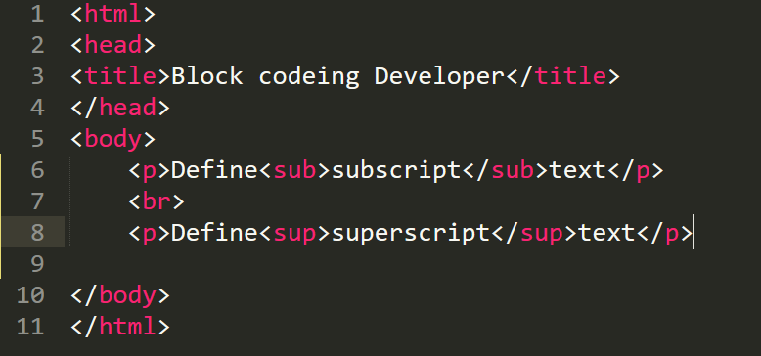
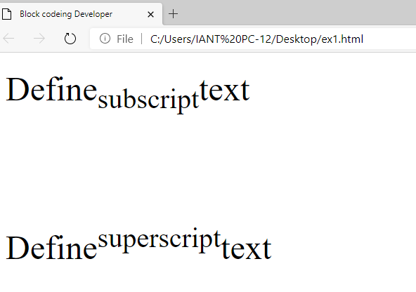
<sub>Tag & <sup> Tag
<b> Define subscript
<strong> Define Superscript

Slide 24
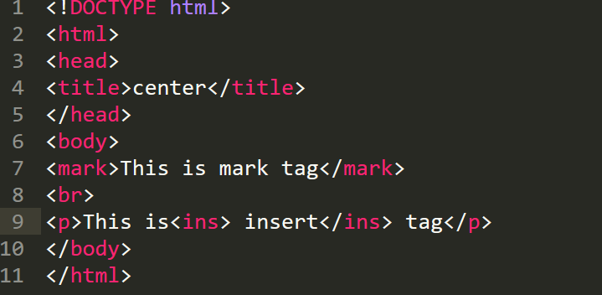
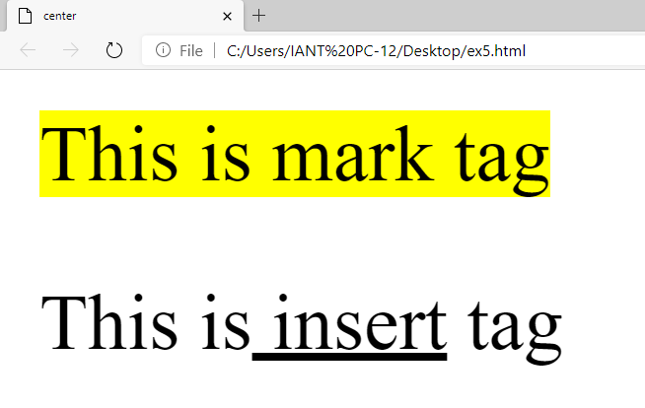
<mark> Tag & <ins> Tag
<mark> Define marked
<ins> For inserted Text

Slide 25
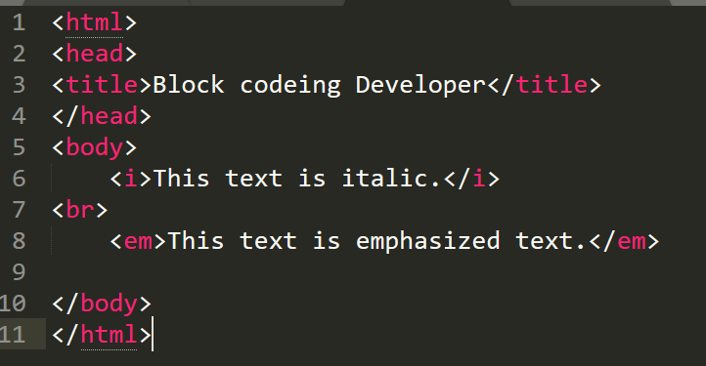
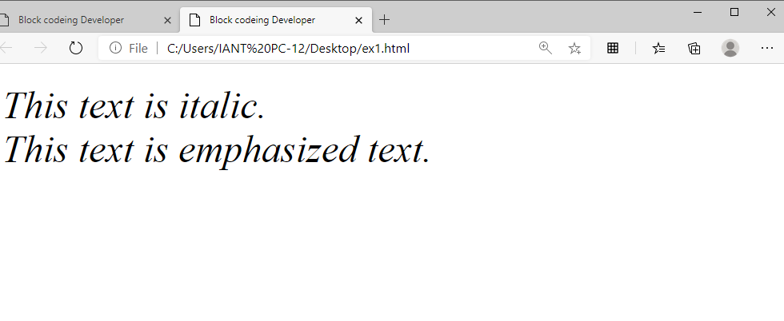
<i> Tag & <em> Tag
<i> Define Italic text
<em> Define emphasized Text Same as <i>

Slide 26
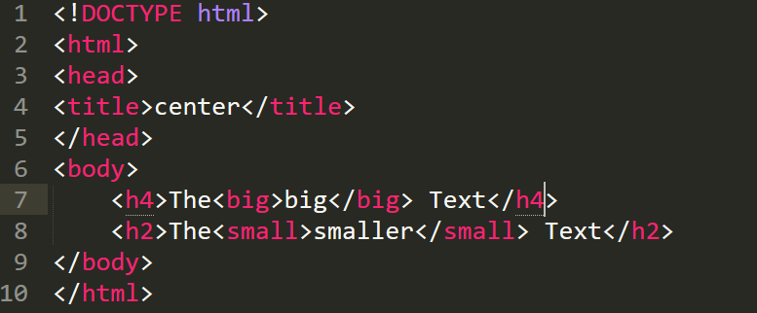
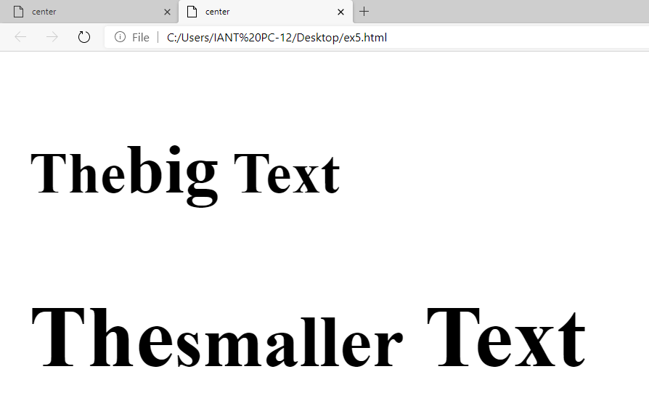
<big> Tag & <small> Tag
<big> For Big Text
<small> For smaller Text

Slide 27

Summary…
HTML Introduction
Structure of HTML
Creating HTML Tag

Slide 28
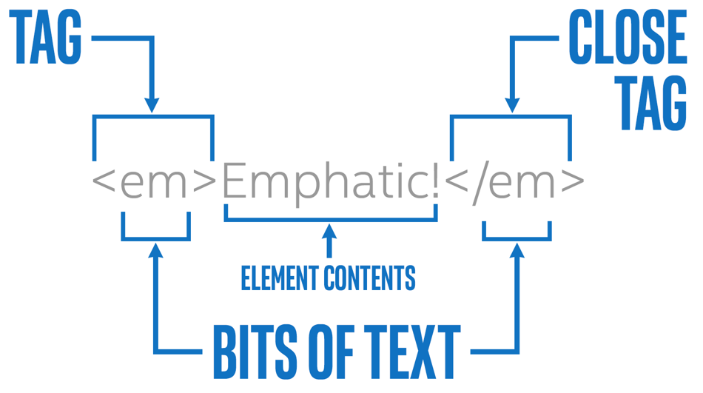
Next Session…
What is Attribute in HTML
What is Elements in HTML
What is Hyperlink in HTML

